Slide 1
FIN 740: Corporate Finance
Topic #3
Investment Decision Rules

Slide 2
Outline for this topic
Discuss capital budgeting and investment decision rules used
Review net present value (NPV)
Other decision rules & their drawbacks
Payback rule
Internal rate of return (IRR) rule
Apply rules using “Investment Detective” case
Miscellaneous decision issues
Handling budget constraints [using profitability index]
Handling unequal periods [using equivalent annual annuity]

Slide 3
Motivation
Managers constantly make major investment decisions; e.g.,
Netflix spent $15 billion on original content in 2019
In 2016, Amazon invested billions to lease its own cargo planes
These are big decisions, and we now want to understand the various tools used by managers to make them
Using net present value is the preferred approach; in words, what is it?

Slide 4
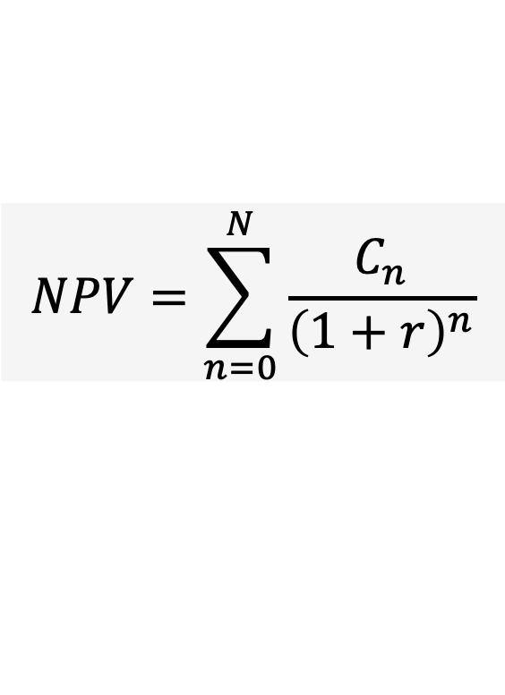
Review of net present value (NPV)
NPV = difference between the present value of a project’s benefits and the present value of its costs
Alternatively (and more commonly), NPV is expressed as the present value of all cash flows associated with the project
NPV = Present value(benefits) – Present value(costs)
$$NPV=\sum_{n=0}^{N}{\frac{C_{n}}{{\left(1+r\right)}^{n}}}$$

Slide 5
Decision rules using NPV
Important: NPV captures the dollar impact on firm value; it is equivalent to receiving that amount in cash today
This leads to two decision rules:
Do projects with NPV > 0; they will create shareholder value
When choosing among projects, take the highest NPV projects

Slide 6
NPV is same as getting cash now – Example
Employee approaches you with following project
Requires immediate investment of $500,000 [i.e., year 0 cash outflow]
Expected benefit = $550,000 next year [i.e., year 1 cash inflow]
Appropriate discount rate and firm’s cost of borrowing is 8%
What is the NPV?
And how can firm convert NPV into cash immediately?

Slide 7
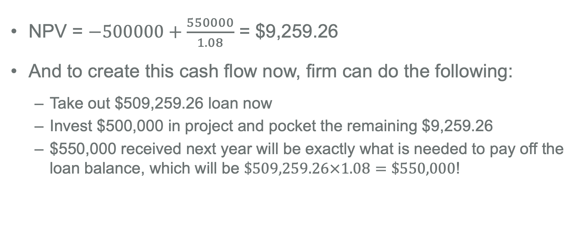
NPV is same as getting cash now – Example
NPV = $−500000+\frac{550000}{1.08}$ = $9,259.26
And to create this cash flow now, firm can do the following:
Take out $509,259.26 loan now
Invest $500,000 in project and pocket the remaining $9,259.26
$550,000 received next year will be exactly what is needed to pay off the loan balance, which will be $\$509,259.26×1.08=\$550,000$!

Slide 8
Outline for this topic
Discuss capital budgeting and investment decision rules used
Review net present value (NPV)
Other decision rules & their drawbacks
Payback rule
Internal rate of return (IRR) rule
Apply rules using “Investment Detective” case
Miscellaneous decision issues
Handling budget constraints [using profitability index]
Handling unequal periods [using equivalent annual annuity]

Slide 9
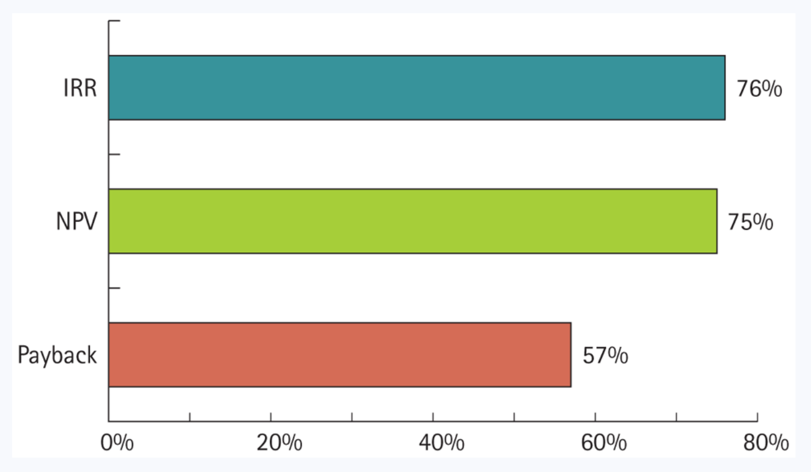
Other popular decision rules
CFO survey showed that three most common decision rules were IRR, NPV, and Payback
You will encounter them; so, let’s discuss!
Percent of CFOs that said they use the following decision rules when making investment decisions
Does anyone know what these two other rules are?
Figure 8.2: Berk, Demarzo, and Harford, Fundamentals of Corporate Finance, 5th Edition

Slide 10
The payback investment rule
Payback period = the amount of time until the cash flows from a project offset the initial investment cost
To compute, first estimate cash flows of project
Then, subtract the future cash flows from the initial cost until initial investment cost is recovered; this yields the “payback period”
Payback investment rule = only undertake projects where their payback period is less than some prespecified number

Slide 11
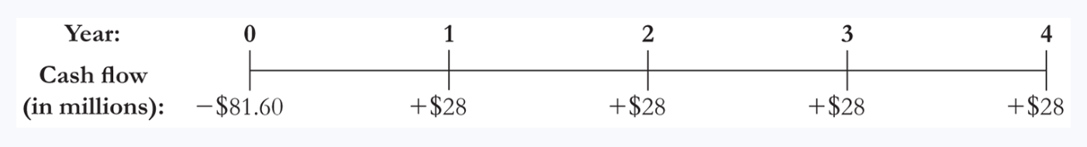
The payback investment rule – Example
Suppose a project has immediate cost of $81.6 million and yields $28 million in cash flows per year for next 4 years
What is the payback period?
Would a firm do project if it requires payback period of 2 or fewer years?

Slide 12
Answers – Computing the payback period
Payback period is 3 years
Year 1: 81.6 – 28 = $53.6 million still to recover
Year 2: 53.6 – 28 = $25.6 million still to recover
Year 3: 25.6– 28 = -$2.4 million [project pays back in year 3]
Firm would reject since it requires 2-year payback period
To illustrate weakness of this approach, let’s now assume appropriate discount rate is 10% and find the NPV…

Slide 13
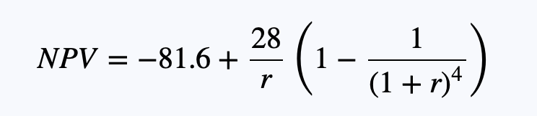
Weakness of payback rule – Example
The NPV of project is $7.2 million
Plug in for r = 10%, and you find NPV = $7.2 million
NPV rule says the firm should do project!
What formula did I use to create the second term?
Intuitively, what are the problems with using the payback rule?

Slide 14
Disadvantages of payback rule
While simple to use, payback rule has problems:
No guidance on economically based (i.e., correct) payback period
Ignores time value of money [didn’t discount future cash flows]
All cash flows after payback period are ignored
Punchline = Use of the payback rule can lead to decisions that are not consistent with maximizing shareholder value!

Slide 15
The IRR investment rule
Internal rate of return (IRR) = interest rate that sets the net present value of the project equal to zero
To compute, must use “trial-and-error” approach [i.e., you make an initial educated guess and keep trying until you find the IRR]
Or better yet, let MS Excel or financial calculator do this for you
IRR investment rule = accept the project if the IRR exceeds the required return [i.e., cost of capital] of the project

Slide 16
The IRR investment rule – Example
Go back to earlier project
What is the internal rate of return of this project?
Given appropriate discount rate is 10%, should firm do project?

Slide 17
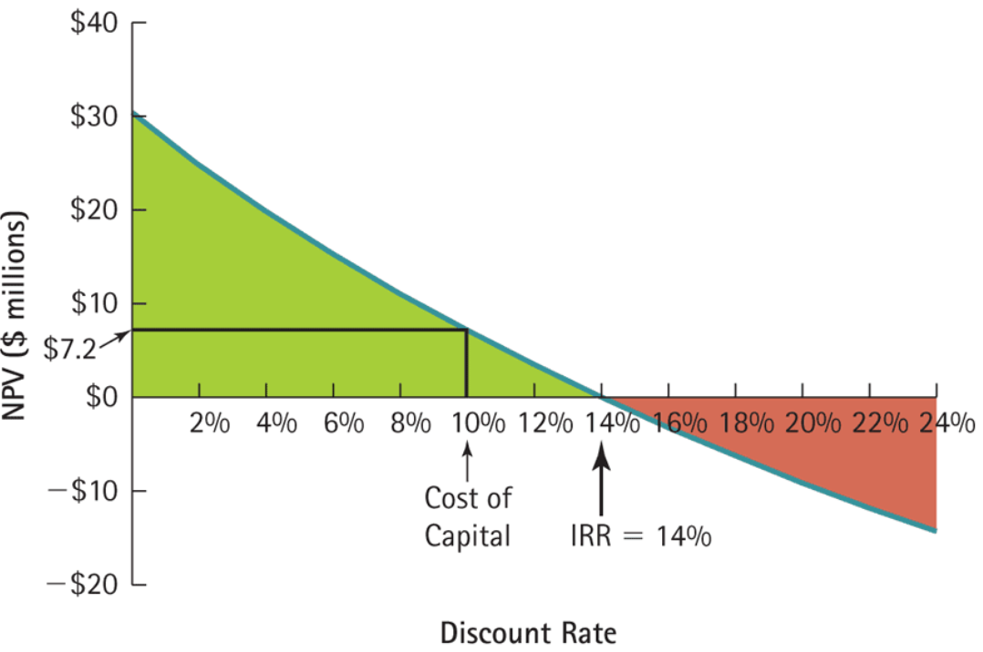
Answers – Computing the IRR
Graph shows NPV for each possible r
IRR is 14%; so yes, firm would do project since this exceeds the required return of 10%
Figure 8.1: Berk, Demarzo, and Harford, Fundamentals of Corporate Finance, 5th Edition

Slide 18
Disadvantages of the IRR rule
It often gives same answer as NPV rule, but not always
We will discuss this in more detail after “Investment Detective” case
See if you and your group can spot the concerns on your own!

Slide 19
Outline for this topic
Discuss capital budgeting and investment decision rules used
Review net present value (NPV)
Other decision rules & their drawbacks
Payback rule
Internal rate of return (IRR) rule
Apply rules using “Investment Detective” case
Miscellaneous decision issues
Handling budget constraints [using profitability index]
Handling unequal periods [using equivalent annual annuity]

Slide 20
Using MS Excel to find NPV & IRR
I recommend using MS Excel formulas to solve next case
See next slide for example formulas
However, one needs to be careful
You need to manually include year 0 cash flow because Excel’s NPV formula assumes first cash flow is in year 1
Don’t leave blank cells because NPV and IRR will ignore them; instead, you should always put ‘0’ for years with no cash flow

Slide 21
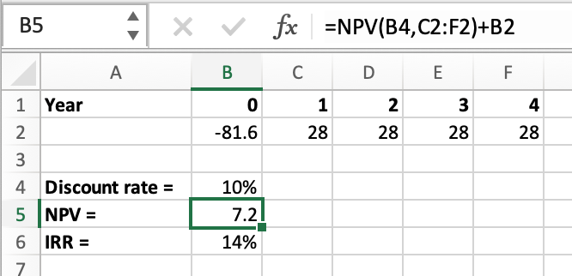
NPV formula in MS Excel
2nd entry tells Excel the cash flows, beginning with year = 1
First entry tells Excel what discount rate to use
Then, need to manually add year = 0 cash flow

Slide 22
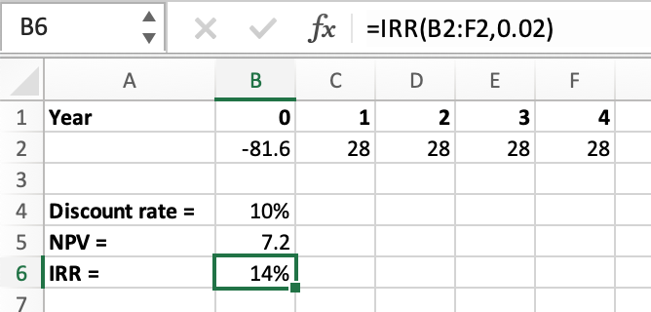
IRR formula in MS Excel
First entry tells Excel the cash flows, beginning with year 0
2nd entry tells Excel where to begin guessing; remember, it is necessary to “guess and check”
Note: If any year has no cash flow, put a ‘0’ so that formulas don’t skip it

Slide 23
Group assignment – Investment detective case
Take 60 minutes as group to answer questions on handout about the “Investment Detective” case
Upload answers as MS Excel, MS Word, or MS PowerPoint file to Canvas [though, it will probably be easiest for you to just use the MS Excel file on Canvas, enter you answers there, and then upload that]

Slide 24
Conflicts between NPV and IRR rules
NPV directly measures the increase in value to the firm
Whenever there is a conflict between NPV and another decision rule, including IRR, you should always use NPV
IRR rule is problematic in following scenarios:
Mutually exclusive projects of different scale
Non-conventional cash flows [which can lead to multiple IRRs]

Slide 25
IRR problem #1 – Differences in scale
IRR tells you you the average percentage return on each invested dollar while NPV tells total dollar impact on value
To see why this is important, consider the following example…
Which of the below would you prefer?
200% return on $1 investment
10% return on $1 million investment

Slide 26
IRR problem #1 – Differences in scale [Part 2]
Answer is obvious. First investment makes $2; second one makes $100,000. Second is clearly better and IRR misses this!
Cannot use IRR to compare projects of different scale
Partly why it gave incorrect answer on choice between projects #7 & #8
Similar issue for length of cash flows; earning lower IRR for more years can lead to higher NPV [see textbook for examples]

Slide 27
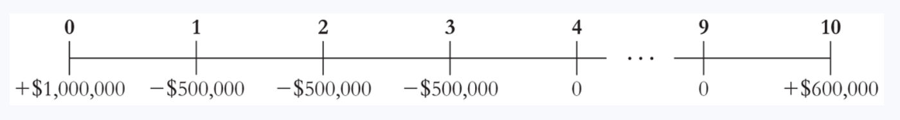
IRR problem #2 – Non-conventional cash flows
Two type of cash flows cash problems for IRR rule
If cash inflows come before the outflows, the positive NPV projects are those with IRR less than cost of capital!
If cash flows switch sign from one year to the next multiple times, there will be more than one IRR!
To see example of last point, consider this stream of cash:

Slide 28
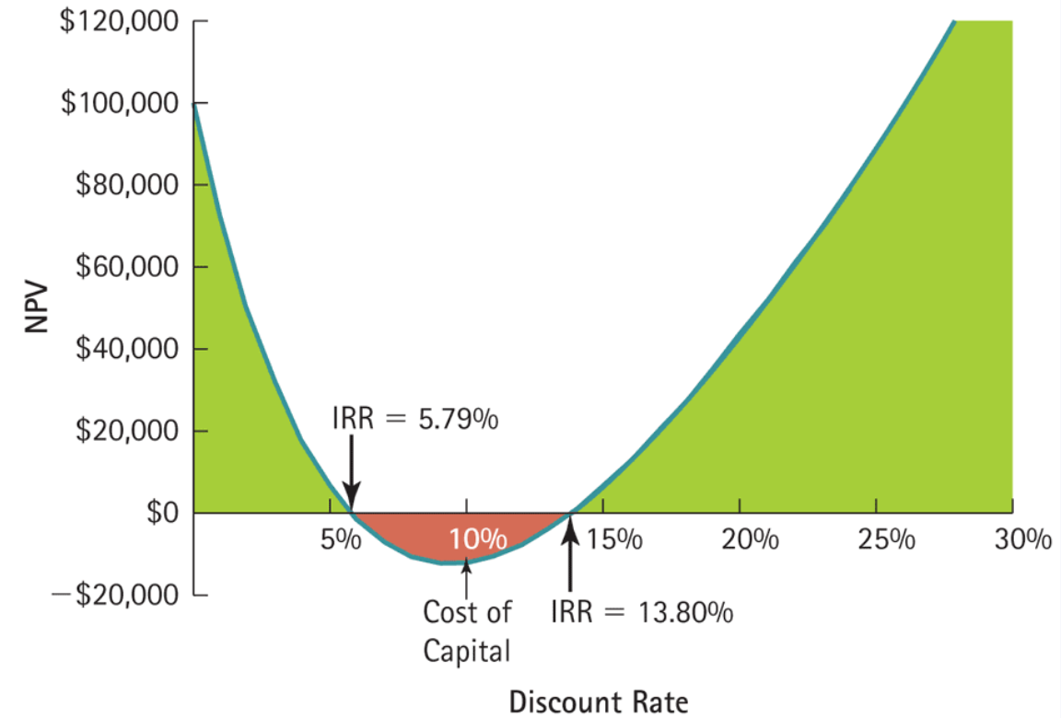
IRR problem #2 – Example
Because cash flows switch signs twice, there are two IRRs
There are two IRRs!
Figure 8.4: Berk, Demarzo, and Harford, Fundamentals of Corporate Finance, 5th Edition

Slide 29
Summary of NPV & IRR investment criteria
Net present value
Gives dollar impact on value; rule says take project if NPV > 0, and if choosing between projects, you take the one with highest NPV
Has no serious problems… it is our preferred decision criterion!
Internal rate of return
Gives average return; rule says to take project if IRR > cost of capital
IRR cannot can be used to compare projects of different scale and IRR rule is unreliable when cash flows are non-conventional

Slide 30
Outline for this topic
Discuss capital budgeting and investment decision rules used
Review net present value (NPV)
Other decision rules & their drawbacks
Payback rule
Internal rate of return (IRR) rule
Apply rules using “Investment Detective” case
Miscellaneous decision issues
Handling budget constraints [using profitability index]
Handling unequal periods [using equivalent annual annuity]

Slide 31
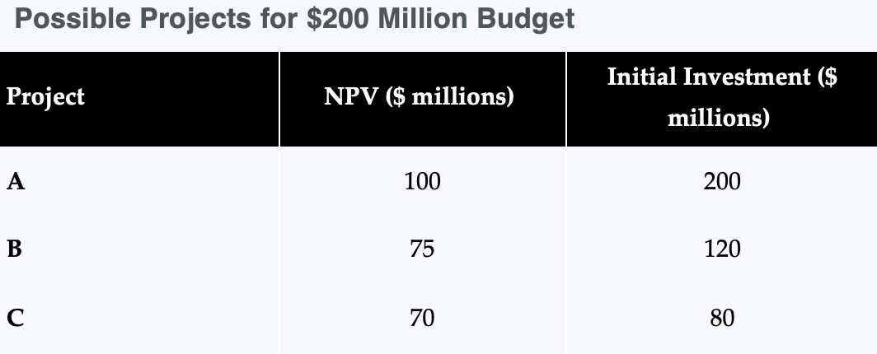
Handling resource constraints
When projects use up a limited resource, you might not want to just undertake the projects with the highest NPVs
For example, suppose company only has $200 million that it can invest; which of the below projects should it choose?

Slide 32
Handling resource constraints [Part 2]
Answer = Should do projects B & C for NPV of $145 million
While project A has highest NPV of $100 million, doing it would consume all the resources and prevent firm from doing a second project

Slide 33
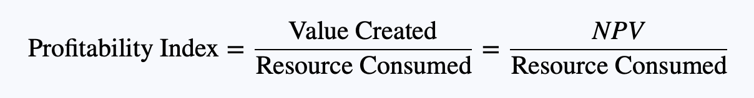
Profitability index provides a solution
Profitability index = NPV per unit of resource consumed [think of this as “bang for your buck”]

Slide 34
Profitability index rule
Profitability index rule = Sort projects by profitability index, then choose from highest to lowest until resource is consumed [skipping projects you lack resources to choose]
I.e., you might choose projects ranked #1, #2, and #4 because after doing #1 and #2 you lack the resources for doing #3, but have the necessary resources to do project #4

Slide 35
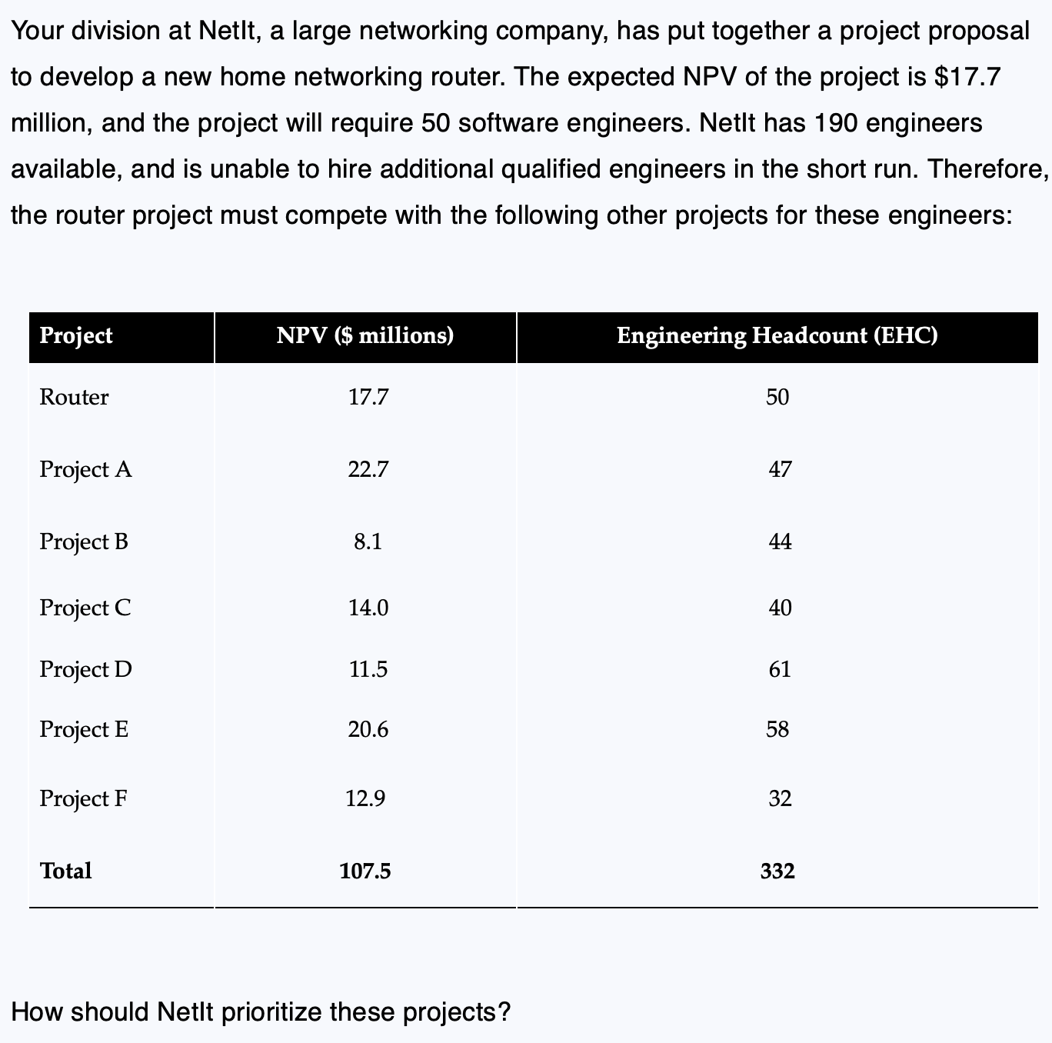
Practice question [Example 8.6 from textbook]
Take 10 minutes to answer this question

Slide 36
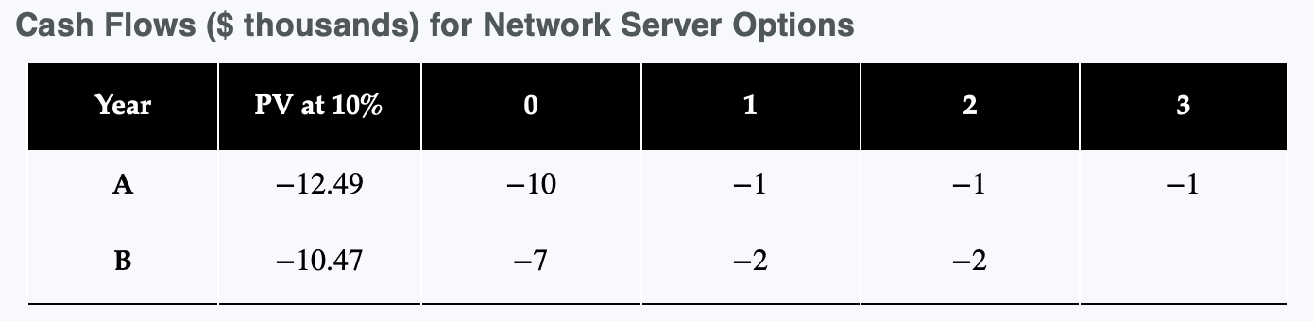
Handling unequal periods
Often companies need to choose between two solutions
E.g., firm needs to choose between two network servers: A or B
‘A’ is more expensive, but uses less energy and lasts longer
‘B’ is cheaper, but uses more energy and burns out quickly
Cash flows are all negative because they are costs; Firm wants to minimize costs given its 10% discount rate
How would you make the decision?

Slide 37
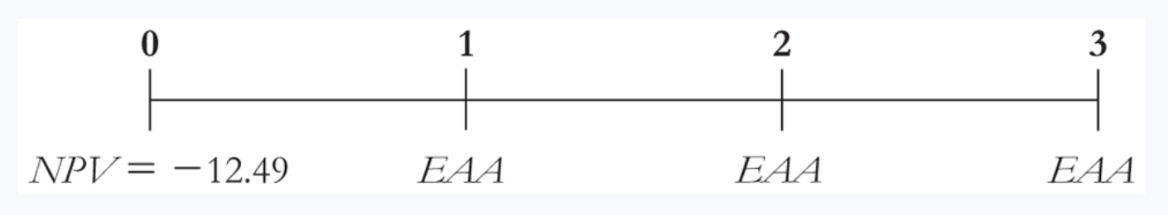
Handling unequal periods [Part 2]
Answer = Break total PV of costs into “equivalent annual annuity” (EAA) and take choice that has lower EAA
Equivalent annual annuity (EAA) = The level of annual cash flow that has same present value as the cash flows of the project; e.g.,
Intuitively, you compare costs on annual basis
Can find EAA using present value annuity formula; see next slide for example

Slide 38
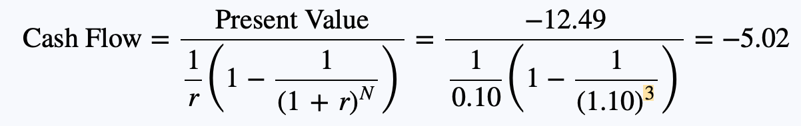
Handling unequal periods – Example
Total PV of ‘A’ costs
EAA of network server ‘A’ given by
This is just rearranged present value of annuity formula, where we now solve for implied cash flow (i.e., EAA)
Firm’s cost of capital, which was 10%
Total # of years ‘A’ will last

Slide 39
Handling unequal periods – Example
EAA of network server ‘A’ given by -$5.02 million
Using same approach, can find EAA of ‘B’ is -$6.03 million
Which should firm choose?
Company should choose server ‘A’ because its implied annual cost, $5.02 million, is less than implied annual cost of server ‘B’, $6.03 million

Slide 40
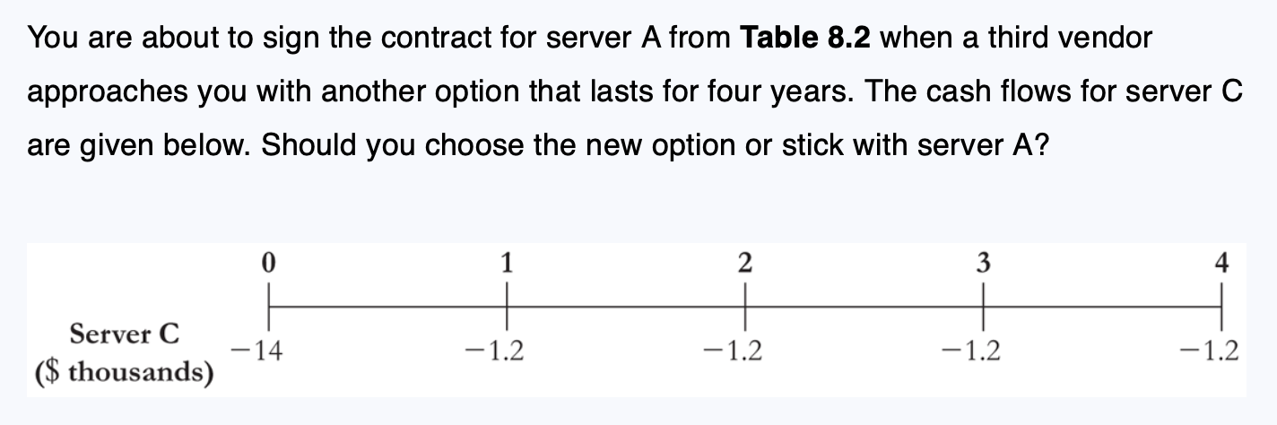
Practice question [Example 8.5 from textbook]
Take 5 minutes to answer below question

Slide 41
Key points to remember
Firms use many investment decision rules
But NPV rule is ‘best-in-class’ in maximizing shareholder value
IRR and payback rules each have serious downsides
Can use profitability index to help choose between projects when there is a resource constraint to consider
See MyLab Finance homework for yet even more opportunities to practice these concepts & calculations

Slide 42
Where we are going next…
Thus far, I’ve always given you needed inputs for NPV
In the next two topics, I will show you how to find the two key inputs needed in the NPV calculation:
Cash flows [Topic #4]
Discount rate [Topic #5]
But first, any questions before we move on?

